Slide 1
Cross-lingual Word Representations
Shyam Upadhyay
CIS 530 – Computational Linguistics (Guest Lecture)

Slide 2
Who is this guy?
5th year PhD student with Prof. Dan Roth.
Recently defended my thesis.
Thesis Title: Exploiting Cross-lingual Representations for NLP.
Working on cross-lingual NLP problems since 2015-ish.

Slide 3
Today’s theme: NLP for other languages

Slide 4
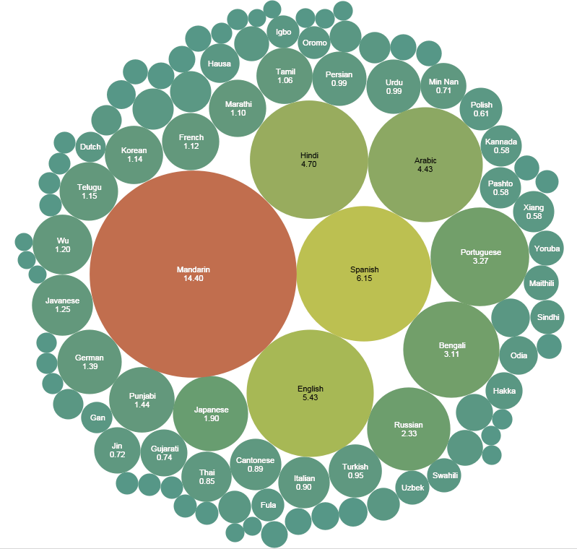
Why should I care about other languages?
Natural Language Processing != “English Language Processing”
25 languages with >50M native speakers.
>40% of the Web is NOT English.
Yet most NLP resources are available predominantly in English.
English 5% native speakers
https://en.wikipedia.org/wiki/Languages_used_on_the_Internet
https://en.wikipedia.org/wiki/List_of_languages_by_number_of_native_speakers
Notes:
How many of you learnt something other than English as their first language?
How many of you have relatives who learnt something other than English as their first language?
The way we interact with technology should not be limited to English.
Well firstly NLP should not be restricted to only English. Why?
Other widely used languages.
Only 5% of the world population speak Eng natively
and over 40%
Despite of this, Yet most NLP applications have been aimed at English.

Slide 5
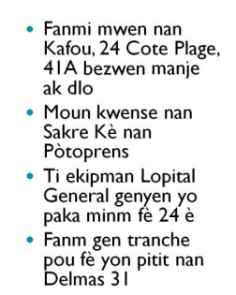
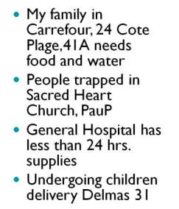
Why should I care about other languages?
Social Impact
Early Warning Systems, Disaster relief, Response to unexpected events.
Example from
Yulia Tsvetkov’s JSALT slides (CMU)
Improving NLP in General
Test-beds for evaluating existing NLP techniques used in English.

Slide 6

Example: Document Classification in French
Science
French
?
Politics
Sports
Entertainment
Let’s see how one would solve this in English first…
Notes:
So lets take a simple problem and try to solve it in a different language.

Slide 7

Document Classification in English
English
Science
Politics
“NASA”
“shuts”
“down”
“Mars”
“rover”
Sports
We need to represent a document
using features of smaller units (the words).
Entertainment

Slide 8

(Monolingual) Word Representations
Word Embeddings in English
English Corpus
car
book
bike
magazine
king
muffin
queen
cake
Task Invariant.
NER, Dependency Parsing, POS tagging, SRL …
Easy to train.
Fast implementations like word2vec
Raw text extremely easy to find.
Compact representations.
Large vocabularies can be represented using 100 dimensional vectors.
Notes:
Here is how its done in English

Slide 9
A Simple Document Classifier
English
Science
Politics
Document’s
Feature vector
“NASA”
“shuts”
“down”
“Mars”
“rover”
Sports
•
Entertainment
Learnable
Weight Vector
(one for each class)
Training Data

Slide 10
Back to building the French classifier …

Slide 11
Attempt 1: Traditional Approach
Training Data in English
Training Data in French
Feature Extraction
Learning Algorithm
Learnt Model
Notes:
\mathcal{A}: (\textcolor{red}{\Phi(\mathbf{x})},\textcolor{red}{\mathbf{y}}) \to \textcolor{red}{\mathbf{M}}
\textcolor{blue}{\mathbf{M}}: \textcolor{blue}{\Phi(\mathbf{x})} \to \textcolor{blue}{\mathbf{y}}

Slide 12
Limitations of Attempt 1
No sharing of information between languages.
E.g., if “NASA” appears in a document ...
Cannot work with little supervision in French
Need to annotate French documents from scratch ...
Worst case – No supervision in French.

Slide 13
Attempt 2: Machine Translation (MT)
MT
French
Model
Predictions
English Train
French Train
Translate Train
?
French Test
?
MT
English
Model
Predictions
?
French Test
English Test
Translate Test

Slide 14
Limitations of Attempt 2
Good MT models are hard to develop
Expensive resources, training etc.
Prevents fast scaling to new languages.
MT is unlikely to be perfect … mismatch in train and test conditions.
Do you really need MT for something like document classification?
Elon Musk: le vaisseau spatial de nouvelle génération
de SpaceX sera construit et lancé en Floride
Downing street bittet Brüssel förmlich um Verspätung,
da May auf einen neuen Deal drängen will

Slide 15
Ideally …
We should combine all available supervision, and share information across languages (what we learn for English could be applied to French)
Training Data in English
Training Data in French
To share supervision, we need features (word embeddings)
that are language-invariant.

Slide 16
Language Invariant Word Representations
Word Embeddings in English
livre
car
book
bike
voiture
magazine
French Corpus
English Corpus
velo
magazine
king
roi
queen
reine
Word Embeddings in French
With language invariant representations,
the vector for book and livre look (almost) identical to a classifier.

Slide 17
Building NLP Models using Language-invariant (Cross-lingual) Spaces

Slide 18
Direct Model Transfer (through Shared Cross-lingual Space)
Training Data in English
Test Data in French
?
Shared Cross-lingual Space
Learning Algorithm
Learnt Model

Slide 19
Joint Training (through Shared Cross-lingual Space)
Training Data in English
Training Data in French
Shared Cross-lingual Space
Learning Algorithm
Learnt Model
Notes:
More practical approach than direct model transfer, in that it leads to better performance

Slide 20
How to learn cross-lingual spaces?

Slide 21
What’s wrong with this?
Word Embeddings in English
English Corpus
car
book
bike
magazine
king
queen
Word Embeddings in French
French Corpus
voiture
livre
velo
magazine
roi
reine

Slide 22
Things are more complicated …
voiture
livre
velo
magazine
car
book
bike
magazine
roi
reine
king
queen
Limitations
Unable to capture related-ness between words across languages.
Book and Livre will look very different to the classifier, defeating the purpose.

Slide 23

Another way to think about it …
Need some cross-lingual signal to align the spaces
from https://www.samtalksml.net/aligning-vector-representations/

Slide 24
General Idea
Vectors in English
Monolingual Distributional Information
Cross-lingual
Alignment
Cross-lingual Representation Learning Algorithm
Monolingual Distributional Information
Vectors in French
Vectors for French
Mono. Obj. for French
Vectors for English
Mono. Obj. for English
Cross-lingual Obj.

Slide 25
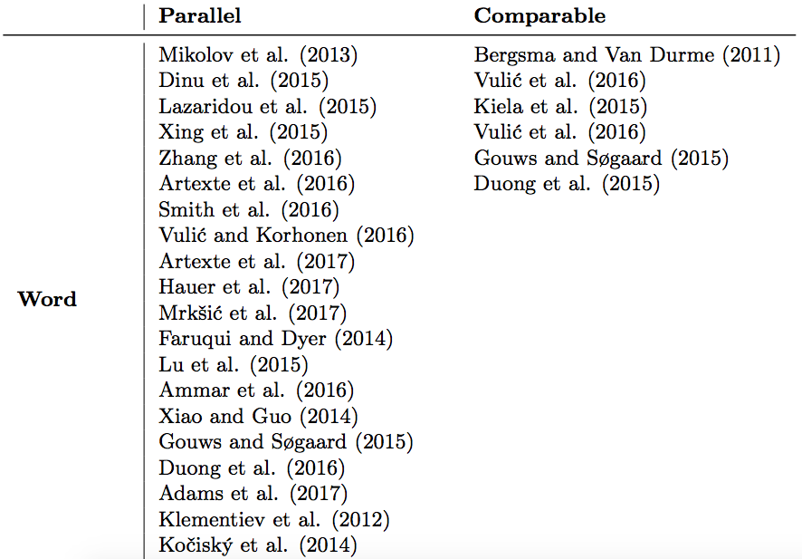
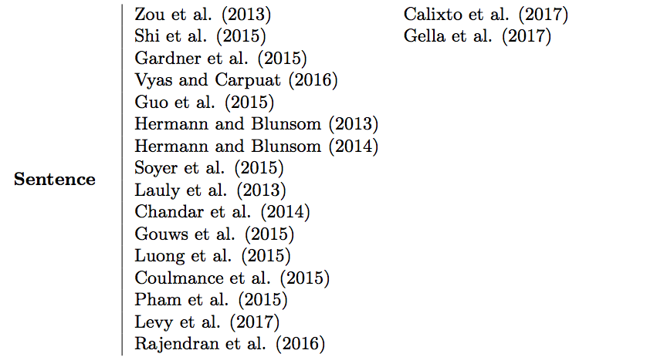

Different Forms of Cross-lingual Alignments
Today’s lecture will cover 3 resources to derive these alignments
Parallel Text Bilingual Dictionaries Comparable Documents
Ruder et al. (2018)

Slide 26



Parallel Text
Consists of sentence pairs that are translations of each other.
English: In the beginning God created the heavens and the earth.
Spanish: En el principio Dios creó los cielos y la tierra.
English: The chair recognizes the representative from Belgium.
Spanish: El presidente reconoce al representante de Bélgica.
English: No, I am your father.
Spanish: No, yo soy tu padre.

Slide 27
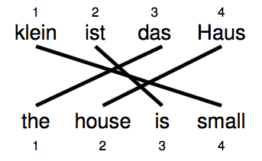
Deriving Word Alignments from Parallel Text
Borrowed from Philipp Koehn’s slides

Slide 28
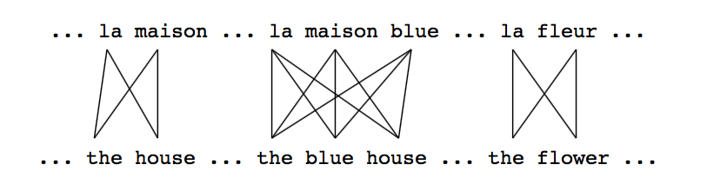
Word Alignments from Parallel Text
Borrowed from Philipp Koehn’s slides
Notes:
All alignments are equally likely
Counts reveal that la often aligns with the

Slide 29
Word Alignments from Parallel Text
Borrowed from Philipp Koehn’s slides
Notes:
All alignments are equally likely
Counts reveal that la often aligns with the

Slide 30
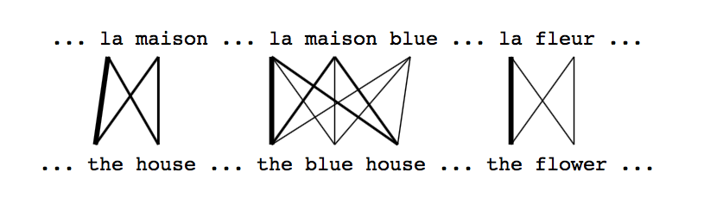
Word Alignments from Parallel Text
Borrowed from Philipp Koehn’s slides

Slide 31
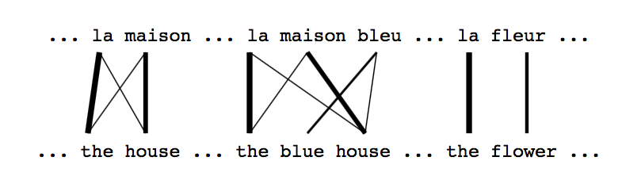
Word Alignments from Parallel Text
Borrowed from Philipp Koehn’s slides

Slide 32
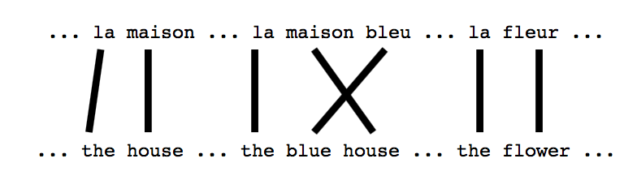
Word Alignments from Parallel Text
Borrowed from Philipp Koehn’s slides

Slide 33
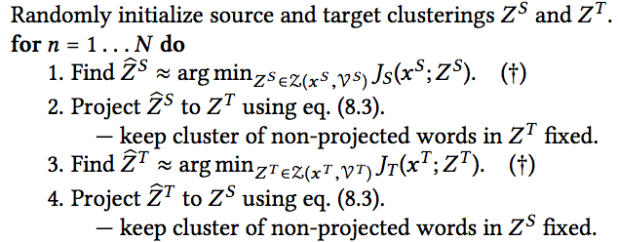
First Attempt – Cross-lingual Word Clusters
Decide the number of clusters.
Randomly initialize clusters in English and Spanish.
Cluster words in English monolingually.
Project words in Spanish to English clusters using word alignments.
Cluster words in Spanish monolingually.
Project words in English to Spanish clusters using word alignments.
Repeat.
A word in Spanish is assigned to the English cluster with which its most often aligned.
Täckström et al. (2012)

Slide 34
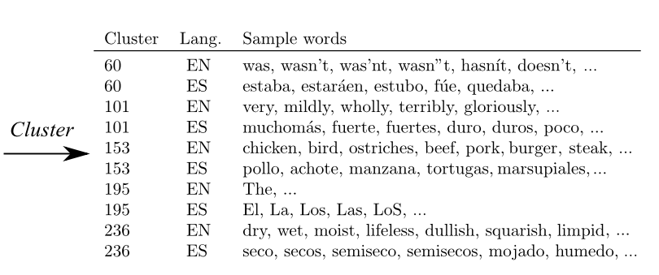
Cross-lingual Word Clusters
Täckström et al. (2012)

Slide 35
Issues with Cluster Based Approaches
Slow to train
Scales quadratically in the number of clusters!
Expressivity tradeoff.
“Hard” partitioning of the space
Similarity between words is discretely defined.
The cluster assignment function is usually discontinuous
Cannot do end-to-end learning (e.g., cannot backpropagate to fine-tune word vectors)
Vector-based word embeddings do not suffer from these issues.

Slide 36
The Skip-gram Formulation (word2vec)
An example of a anti-inflammatory [drug] is ibuprofen.
… context …
pivot word
… context …
Mikolov et al. (2013)

Slide 37
Using Parallel Text – Word and Sentence Alignments
An example of a anti-inflammatory [drug] is ibuprofen.
… context …
pivot word
… context …
Word alignment
Un exemple d'un [médicament] anti-inflammatoire est l'ibuprofène
Mikolov et al. (2013)
Luong et al (2015)
Notes:
D_{11}(\textcolor{red}{\mathbf{V}}) = - \sum_{\textcolor{red}{v}}\sum_{\textcolor{red}{v_c} \in \text{Neighbors}(\textcolor{red}{v})}\log
\Pr(\textcolor{red}{v_c} \mid \textcolor{red}{v})
D_{22}(\textcolor{blue}{\mathbf{W}}) = - \sum_{\textcolor{blue}{w}}\sum_{\textcolor{blue}{w_c} \in \text{Neighbors}(\textcolor{blue}{w})}\log
\Pr(\textcolor{blue}{w_c} \mid \textcolor{blue}{w})
D_{21}(\textcolor{blue}{\mathbf{W}},\textcolor{red}{\mathbf{V}}) = - \sum_{(\textcolor{blue}{w},\textcolor{red}{v}) \in Q}\sum_{\textcolor{red}{v_c} \in \text{Neighbors}(\textcolor{red}{v})}\log
\Pr(\textcolor{blue}{v_c} \mid \textcolor{red}{v})

Slide 38
Why do we need all these terms?
An example of a anti-inflammatory [drug] is ibuprofen.
… context …
pivot word
… context …
Un exemple d'un médicament anti-inflammatoire est l'ibuprofène
An example of a anti-inflammatory [drug] is ibuprofen.
… context …
pivot word
… context …
Un exemple d'un médicament anti-inflammatoire est l'ibuprofène
Notes:
1. No french distributional info
2. Too much trust in the word alignment

Slide 39
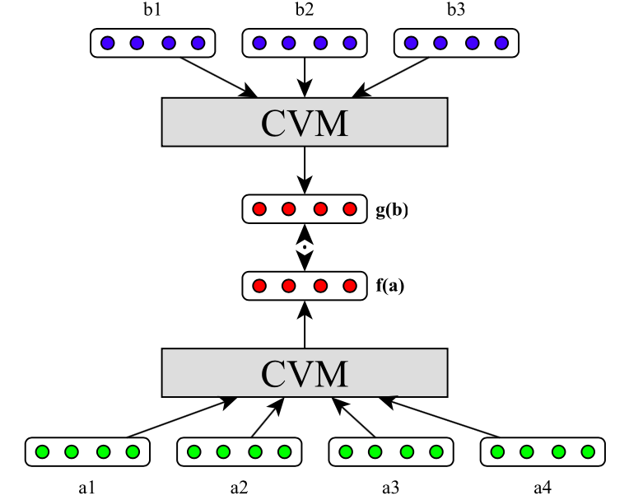
Using Parallel Text – Sentence Alignment Only
Random English Sentence
Loss is zero only if the distance from a random sentence is more than distance with the paired sentence by at least delta.
Hermann and Blunsom (2013)
Notes:
E(\textcolor{red}{\mathbf{v}}, \textcolor{blue}{\mathbf{w}}, \textcolor{blue}{\mathbf{w}^{n}}) = \mathrm{max}\left(\delta + E(\textcolor{red}{\mathbf{v}}, \textcolor{blue}{\mathbf{w}})- E(\textcolor{red}{\mathbf{v}},\textcolor{blue}{\mathbf{w}^{n}}), 0 \right)
E(\vec{v},\vec{w}) &= \Vert f(\vec{v}) - g(\vec{w})\Vert^{2}
E(\textcolor{red}{\mathbf{v}},\textcolor{blue}{\mathbf{w}}) &= \Vert \textcolor{red}{\mathbf{v}} - \textcolor{blue}{\mathbf{w}}\Vert^{2}

Slide 40
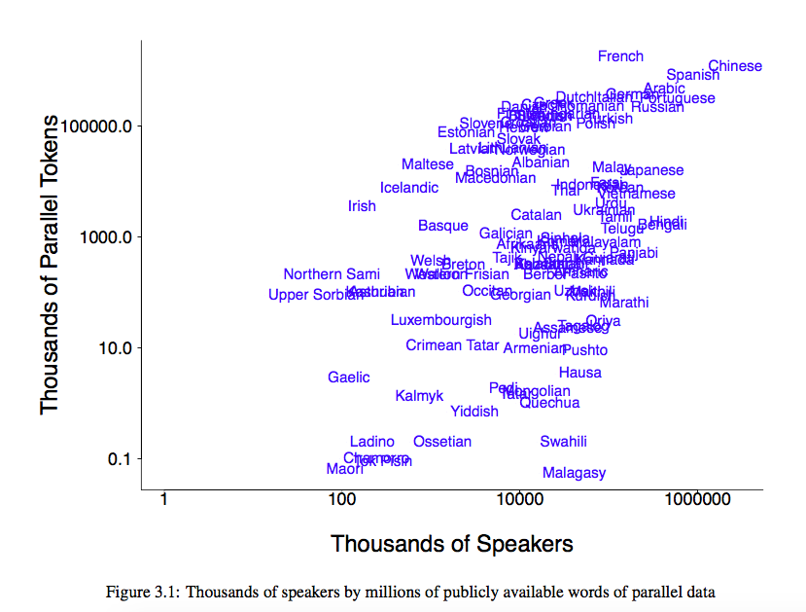
Parallel Text is Scarce
Many languages are not plotted because they don’t have parallel text with English!
Ann Irvine’s Thesis

Slide 41
Using Monolingual Text and Bilingual Dictionary
Word Embeddings in French
Word Embeddings in English
French Corpus
English Corpus
English | French
children | enfants
law | loi
money | argent
world | monde
peace | paix
market | marche
Bilingual Dictionary

Slide 42
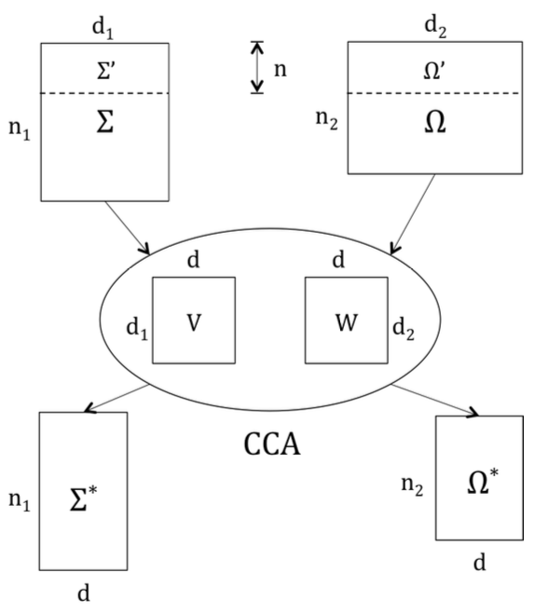
Learning Projections for each language using CCA
Projection directions
CCA finds directions for English and Spanish spaces such that after projection they are “aligned”.
Faruqui and Dyer (2014)
Notes:
\textcolor{red}{\mathbf{V}},\textcolor{blue}{\mathbf{W}} = \text{CCA}(\textcolor{red}{\mathbf{\Sigma'}},\textcolor{blue}{\mathbf{\Omega'}})

Slide 43
Canonical Correlation Analysis (CCA)
aligned
Project the aligned vectors in directions v and w
Efficient ways to compute CCA are available.
(e.g., canoncorr in Matlab)
“Correlation” of the
projected vectors
CCA finds directions that maximize the correlation
Hotelling (1936)
Notes:
\rho(\textcolor{red}{\mathbf{xv}},\textcolor{blue}{\mathbf{yw}}) = \frac{E[\langle\textcolor{red}{\mathbf{xv}},\textcolor{blue}{\mathbf{yw}}\rangle]}{\sqrt{E[\langle\textcolor{red}{\mathbf{xv}},\textcolor{red}{\mathbf{xv}}\rangle]E[\langle\textcolor{blue}{\mathbf{yw}},\textcolor{blue}{\mathbf{yw}}\rangle]}}
= \text{arg}\max_{\textcolor{red}{\mathbf{v}},\textcolor{blue}{\mathbf{w}}}\rho(\textcolor{red}{\mathbf{xv}},\textcolor{blue}{\mathbf{yw}})
\langle \textcolor{red}{\mathbf{Vx}},\textcolor{blue}{\mathbf{Wy}} \rangle = \langle \textcolor{blue}{\mathbf{W}^\intercal}\textcolor{red}{\mathbf{Vx}},\textcolor{blue}{\mathbf{y}} \rangle

Slide 44
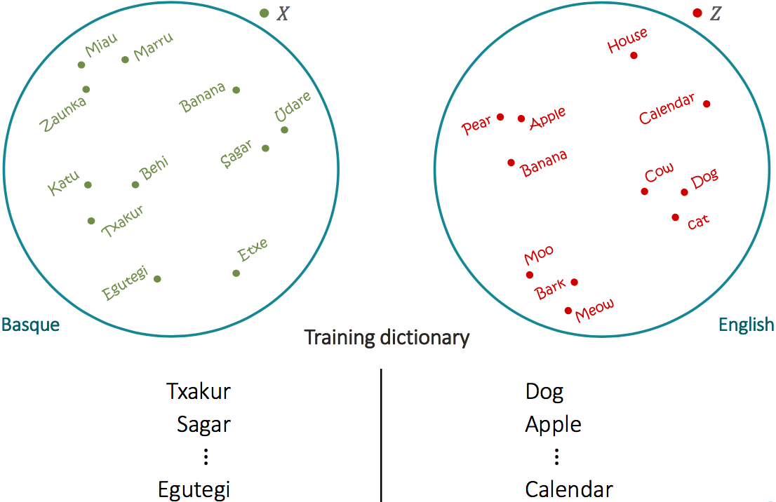
Learning a Single Projection
from Mikel Artexte’s talk

Slide 45
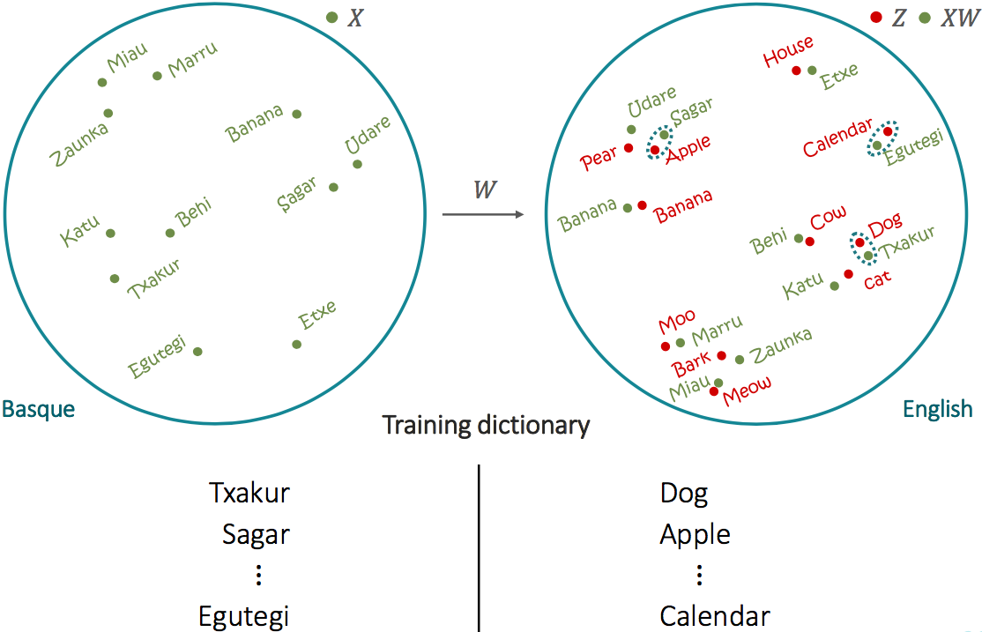
Learning a Single Projection
from Mikel Artexte’s talk

Slide 46
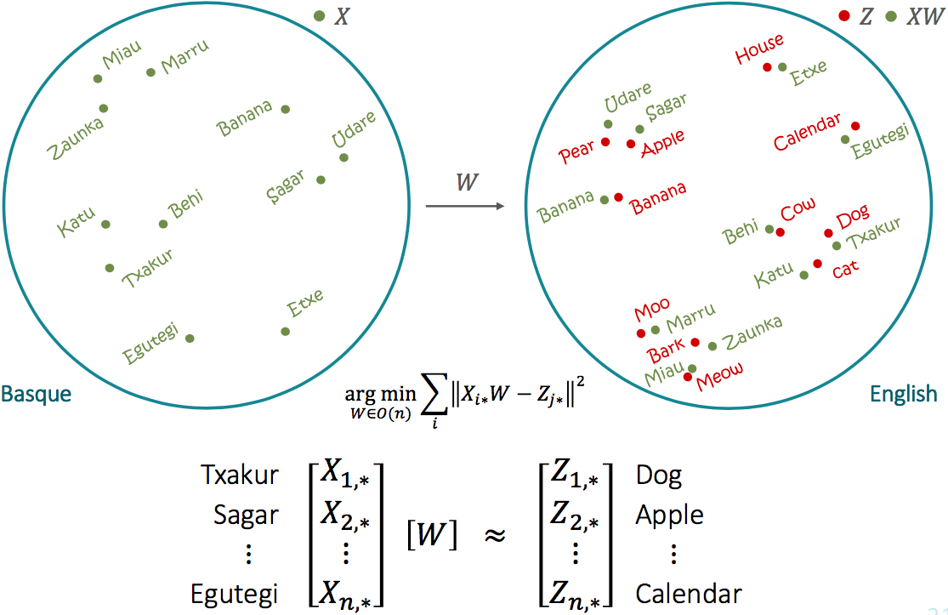
Learning a Single Projection
from Mikel Artexte’s talk

Slide 47
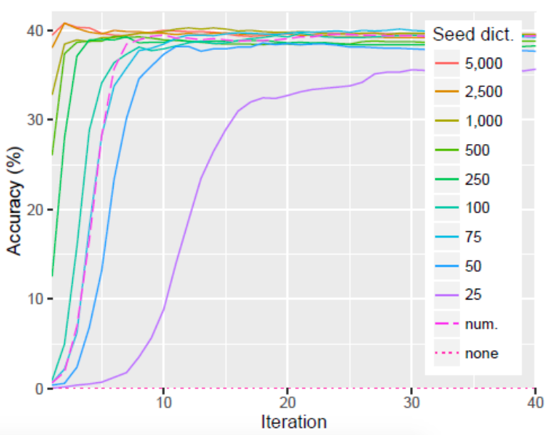
How big a dictionary is needed?
from Mikel Artexte’s talk

Slide 48
How big a dictionary is needed?
Usually ~5k word pairs suffice.
Of course, depends on the quality.
Will bigger dictionaries help?
Yes, but not by much.
Also see DeepCCA (Andrew et al. 2013) for non-linear projections.

Slide 49
Which dictionary will lead to better embeddings?
(Assume translations are perfect.)
superconductor, superconductores
pomegranate, granada
porpoise, marsopa
commandant, comandante
cardiologist, cardióloga
computer, computadora
apple, manzana
dog, perro
love, amor
heaven, cielo

Slide 50
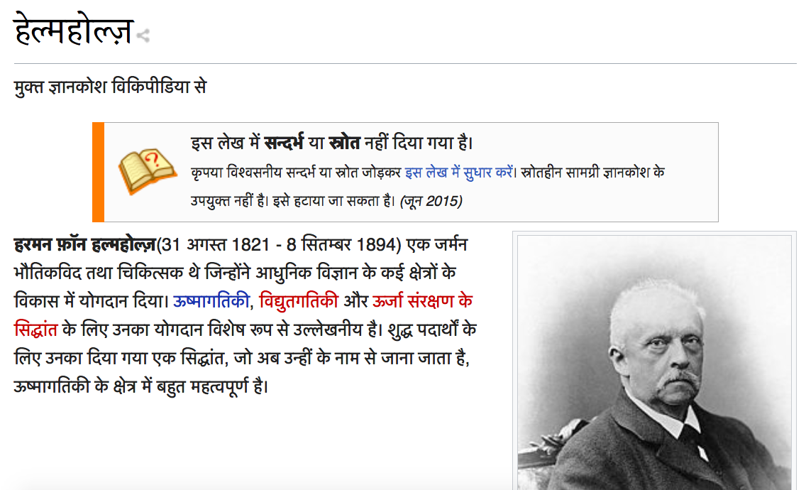
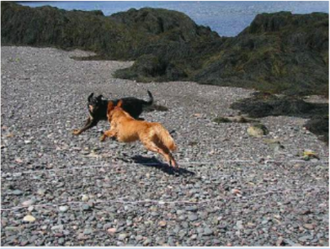
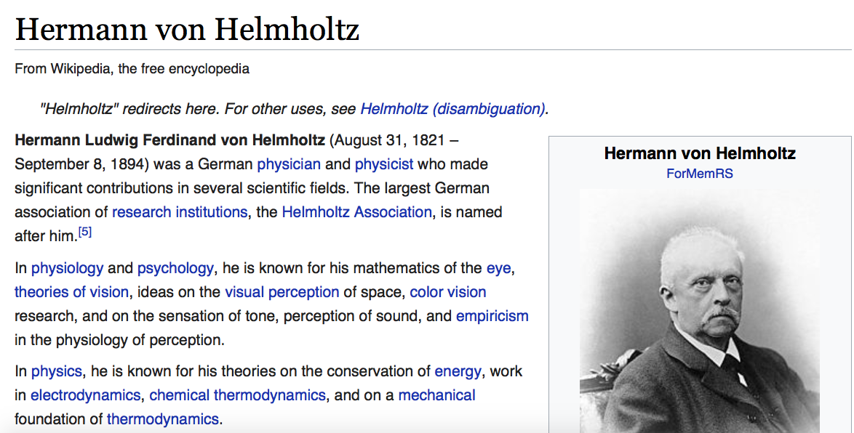
Using Comparable Documents
Comparable documents are only thematically aligned.
(topic, genre, time etc.)
Trump urged Spain to 'build a wall' across Sahara, says minister
La solución de Trump para la crisis migratoria de Europa: construir un muro
(Trump's Solution for Europe's Migrant Crisis - Build a Wall)
English: The brown dog is running after the black dog.
German: Ein brauner Hund und ein schwarzer Hund.
Notes:
Thematically aligned

Slide 51
Advantages / Disadvantages
Relatively easier to obtain than Parallel Corpus.
Lots of News Sources - BBC, VoA …
Wikipedia
Cross-lingual alignment is a bit fuzzy.
One document may contain more/less information than other.
“Unprocessed form of parallel text”

Slide 52
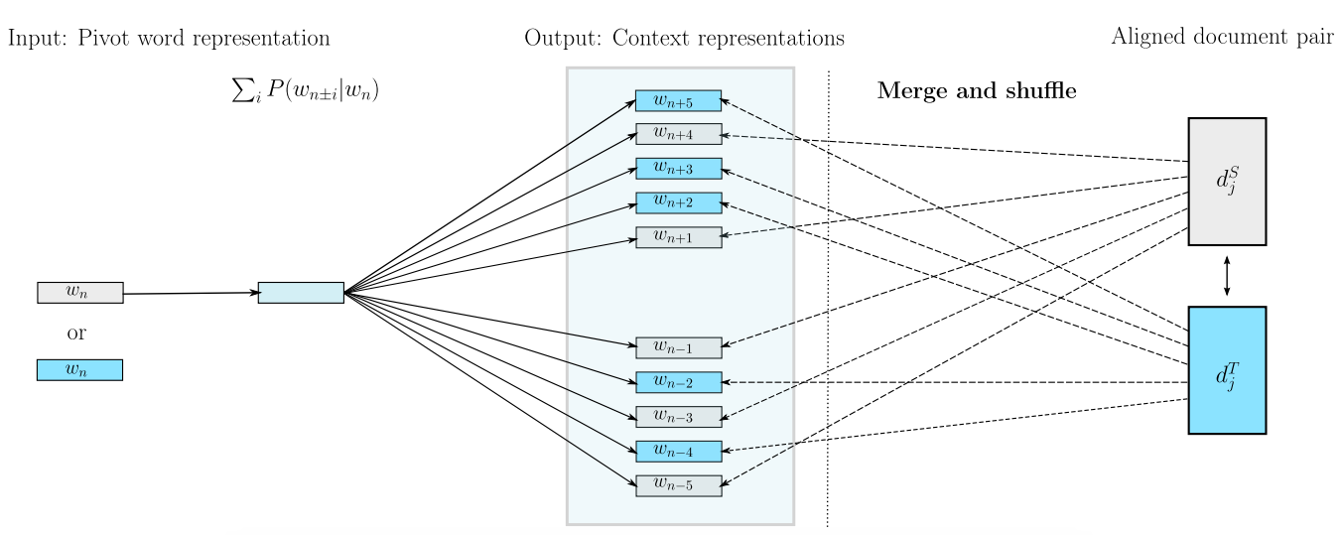
Using Comparable Corpora with word2vec
Vulic and Moens (2016)
Notes:
Thematically aligned

Slide 53
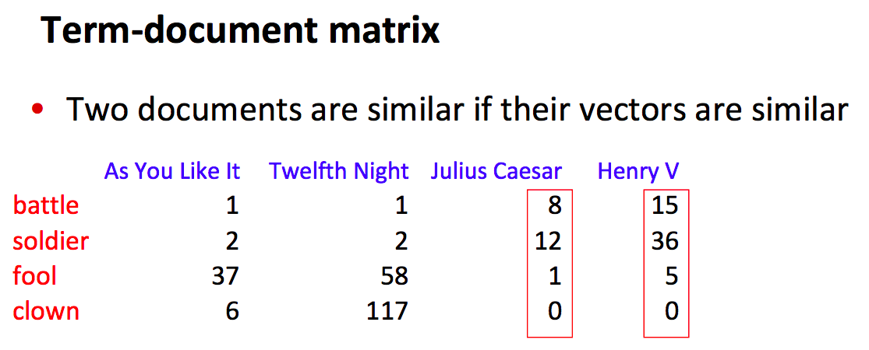
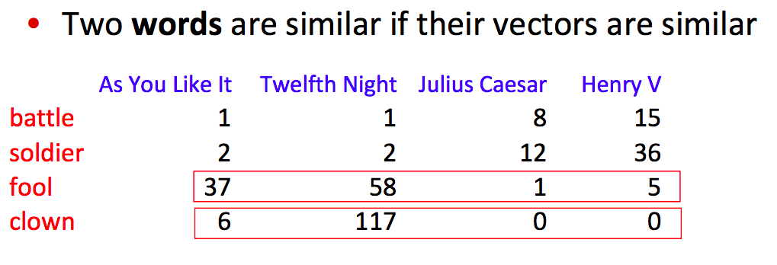
Using Comparable Documents from Wikipedia
Jurafsky and Martin slides

Slide 54
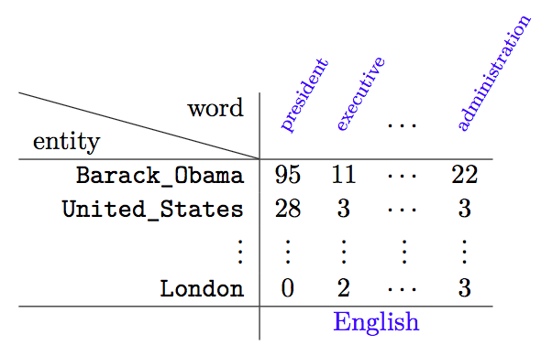
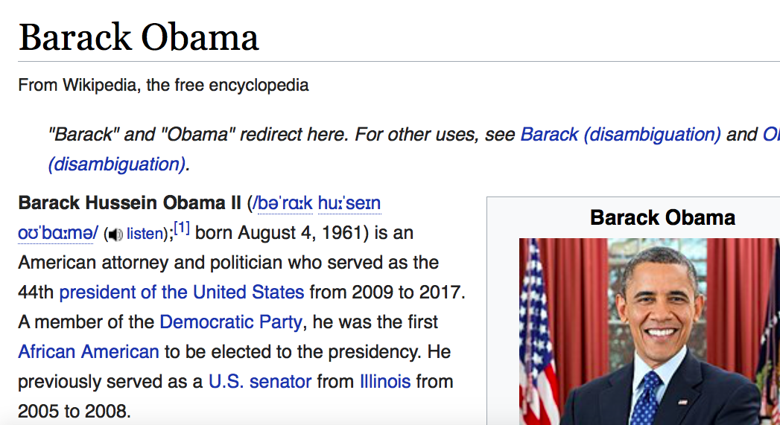
Monolingual Representation from Wikipedia
Also see Explicit Semantic Analysis from Gabrilovich & Markovitch (2009)

Slide 55
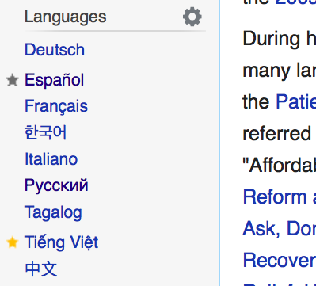
Using Comparable Documents from Wikipedia

Slide 56
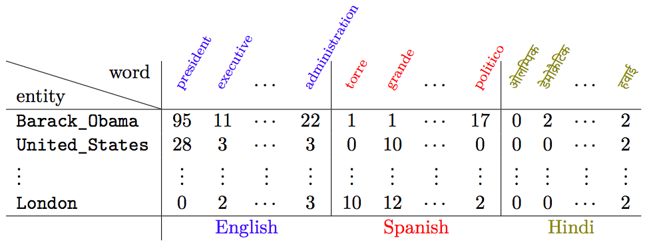
Using Comparable Documents from Wikipedia

Slide 57
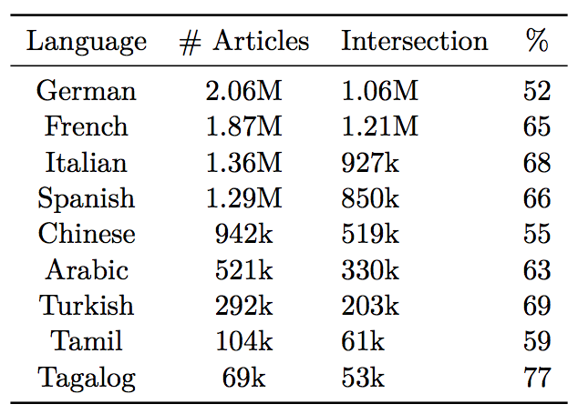
What can go wrong here?
The size of the intersection with English Wikipedia matters!
Smaller intersection means fewer entries in the entity-word matrix.

Slide 58
Quality of the Wikipedia Documents …
Quality and length of Wikipedia articles varies with language (Lewoniewski et al., 2017).

Slide 59
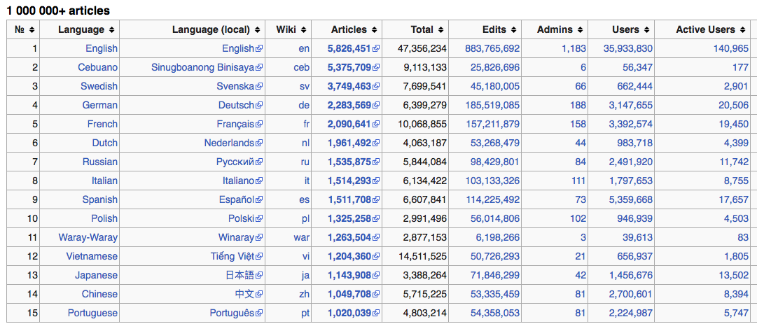
Large Wikipedia != Good Quality
Turns out (most of) Cebuano and Waray-Waray Wikipedia were automatically created.
https://meta.wikimedia.org/wiki/List_of_Wikipedias

Slide 60
Quick Recap

Slide 61
Cross-lingual Representations
Vectors in English
monde
law
world
loi
argent
money
market
Vectors in French
marche
enfants
children
English | French
children | enfants
law | loi
money | argent
world | monde
peace | paix
market | marche
English Corpus
peace
paix
French Corpus

Slide 62
Summary of the Cross-lingual Alignments used
(You, t’)
(Love, aime)
(I, je)
Bonjour! Je t’ aime
Je
t’
aime
Je t’ aime
Hello! How are you? I love you
I
love
you
I love you
Nature of Cross-lingual Alignment
word + sentence
sentence
word
document
Upadhyay et al. (2016)

Slide 63
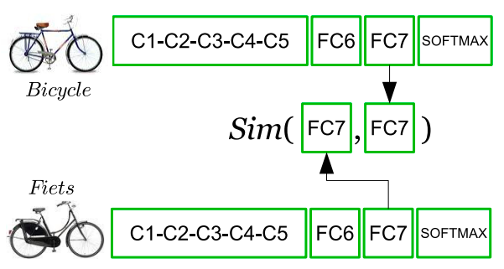
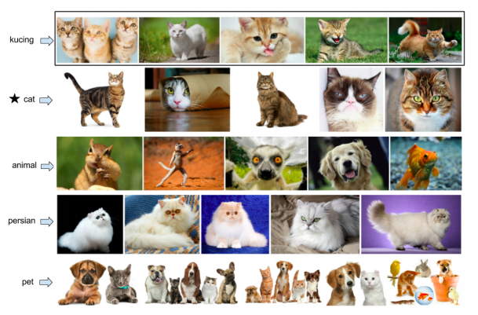
Not covered today …
Visual Alignment
Kiela et al. (2015)
Hewitt*, Ippolito* et al. (2018). Work done at UPenn with Chris!

Slide 64
Going Multilingual

Slide 65
Multilingual Word Embeddings
English Vectors
monde
law
world
welt
loi
recht
markt
French Vectors
German Vectors
market
geld
marche
argent
enfants
money
children
English | French | German
children | enfants | kinder
law | loi | recht
money | argent | geld
world | monde | welt
peace | paix | frieden
market | marche | markt
kinder
peace
frieden
paix
Ammar et al. (2016), Smith et al. (2017)

Slide 66
MultiSkip
An example of a anti-inflammatory [drug] is ibuprofen.
… context …
pivot word
… context …
Un exemple d'un médicament anti-inflammatoire est l'ibuprofène
The bank paid me [interest] on my savings.
… context …
pivot word
… context …
Die Bank zahlte mir [Zinsen] für meine Ersparnisse.
Ammar et al. (2016)

Slide 67
Why do I need cross-lingual terms in both directions?
An example of a anti-inflammatory [drug] is ibuprofen.
… context …
pivot word
… context …
Un exemple d'un médicament anti-inflammatoire est l'ibuprofène
The bank paid me [interest] on my savings.
… context …
pivot word
… context …
Die Bank zahlte mir [Zinsen] für meine Ersparnisse.
Notes:
Answer: English acts like a bridge between languages.

Slide 68
Which method should I choose?
I want to train Multilingual vectors for English (en), German (de), Czech (cz), Hindi (hi), Arabic (ar)
Option 1: en-de, en-cz, en-hi, en-ar (English as the bridge)
Option 2: en-de, de-cz, cz-hi, hi-ar (serial bridging)
Option 3: just do all pairs!
The choice of method usually depends on what is available.
Notes:
Will it be possible to get cz-hi data? Or hi-ar? Maybe not

Slide 69
Recap - Canonical Correlation Analysis (CCA)
Notes:
\rho(\textcolor{red}{\mathbf{xv}},\textcolor{blue}{\mathbf{yw}}) = \frac{E[\langle\textcolor{red}{\mathbf{xv}},\textcolor{blue}{\mathbf{yw}}\rangle]}{\sqrt{E[\langle\textcolor{red}{\mathbf{xv}},\textcolor{red}{\mathbf{xv}}\rangle]E[\langle\textcolor{blue}{\mathbf{yw}},\textcolor{blue}{\mathbf{yw}}\rangle]}}
= \text{arg}\max_{\textcolor{red}{\mathbf{v}},\textcolor{blue}{\mathbf{w}}}\rho(\textcolor{red}{\mathbf{xv}},\textcolor{blue}{\mathbf{yw}})
\langle \textcolor{red}{\mathbf{Vx}},\textcolor{blue}{\mathbf{Wy}} \rangle = \langle \textcolor{blue}{\mathbf{W}^\intercal}\textcolor{red}{\mathbf{Vx}},\textcolor{blue}{\mathbf{y}} \rangle

Slide 70
MultiCCA
Perform CCA for English and Spanish.
Project Spanish vectors into the shared space, do not modify English vectors.
Perform CCA for English and German.
Project German vectors into the shared space, do not modify English vectors.
...
Ammar et al. (2016)
Notes:
\rho(\textcolor{red}{\mathbf{xv}},\textcolor{blue}{\mathbf{yw}}) = \frac{E[\langle\textcolor{red}{\mathbf{xv}},\textcolor{blue}{\mathbf{yw}}\rangle]}{\sqrt{E[\langle\textcolor{red}{\mathbf{xv}},\textcolor{red}{\mathbf{xv}}\rangle]E[\langle\textcolor{blue}{\mathbf{yw}},\textcolor{blue}{\mathbf{yw}}\rangle]}}
= \text{arg}\max_{\textcolor{red}{\mathbf{v}},\textcolor{blue}{\mathbf{w}}}\rho(\textcolor{red}{\mathbf{xv}},\textcolor{blue}{\mathbf{yw}})
\langle \textcolor{red}{\mathbf{Vx}},\textcolor{blue}{\mathbf{Wy}} \rangle = \langle \textcolor{blue}{\mathbf{W}^\intercal}\textcolor{red}{\mathbf{Vx}},\textcolor{blue}{\mathbf{y}} \rangle

Slide 71
Questions
Say I have aligned 100 languages using MultiSkip or MultiCCA.
What happens when I want to add a new language?
Which method is preferable?
Both MultiSkip and MultiCCA (as described today) use English as the bridge.
Say I want to align Russian, Ukranian, Slovenian and English together.
What can go wrong?

Slide 72
Using Multilingual Encyclopedic Resources

Slide 73
Evaluation of Cross-lingual Representations

Slide 74
Two forms of Evaluation
Intrinsic
How good are vectors at representing word meaning and relationships?
Involves probing vectors to see if they encode known relationships.
E.g., can we identify the correct translation using the vectors?
Extrinsic
How good are vectors when used as features in downstream tasks?
Involves using the vectors as features in a model performing a different task
E.g., use word vectors for doing NER.

Slide 75
Bilingual Dictionary Induction
Vectors in English
baisse
Gold Dictionary
(white, blanc)
…
(past, passe)
…
(watch, garde)
…
(school, école)
…
…....
past
passe
Top 10
Nearest
Neighbors
…...........
Vectors in French
accepter
Accuracy@10 – How often is the correct translation in the top-10 neighbors?

Slide 76
Some Results
word + sentence
sentence
word
document

Slide 77
Cross-lingual Document Classification
English Vectors
French Vectors
Training Algorithm
Trained Classifier
Test Documents in French
Predictions
Train Documents in English
Training on English
Testing on French

Slide 78
Some Results
word + sentence
sentence
word
document

Slide 79
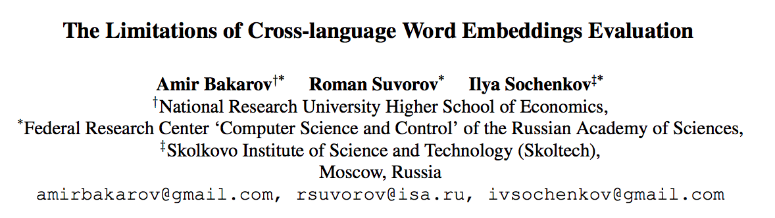
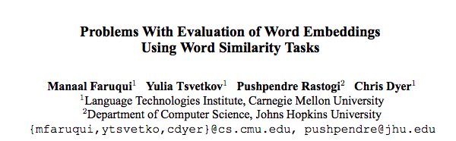
Which evaluation is better? Intrinsic or Extrinsic?
Hope is “good performance intrinsic evaluation leads to good performance on extrinsic evaluation”.
Rarely true in practice.
Intrinsic evaluation is still useful (but not sufficient).

Slide 80
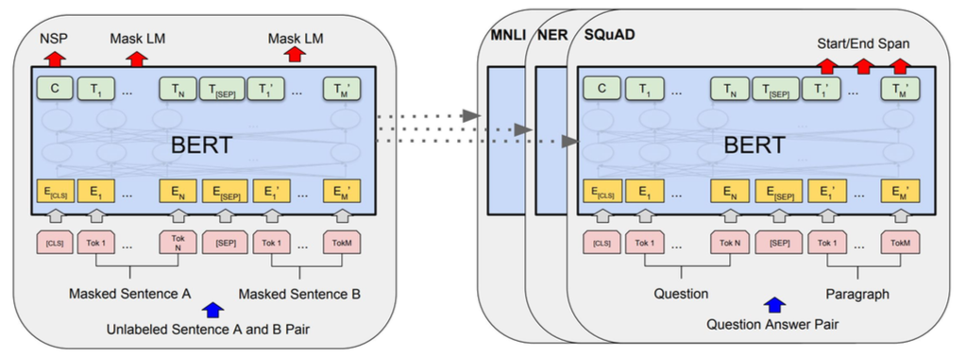
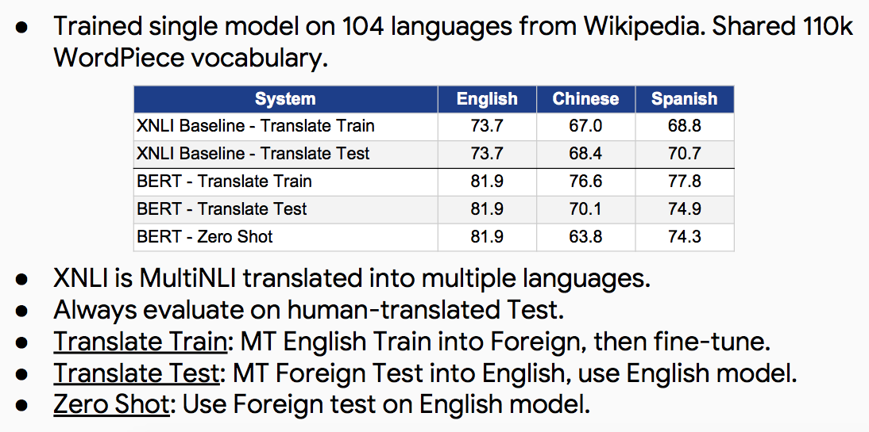
Recent Work – Multilingual BERT
We discussed some of these techniques earlier today

Slide 81
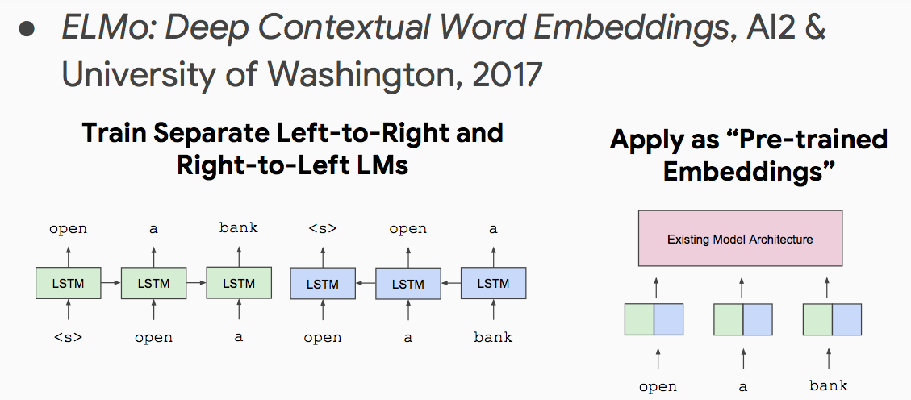
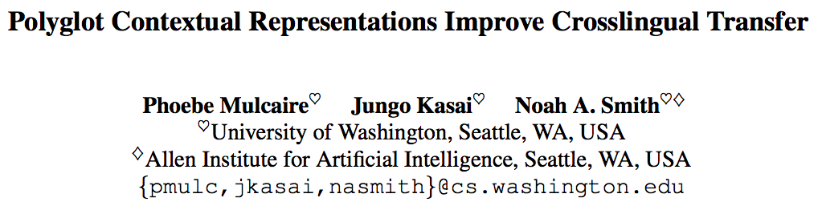
Recent Work – Multilingual ELMo

Slide 82
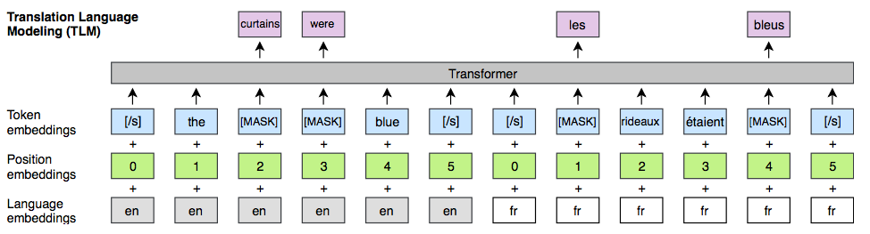
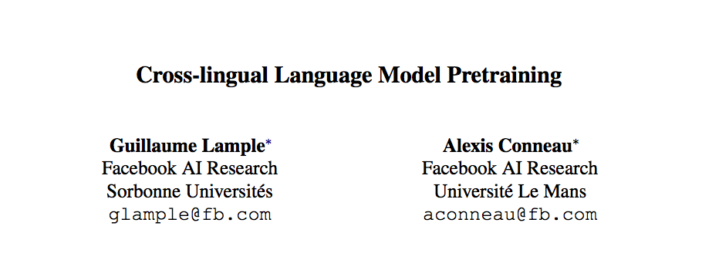
Recent Work – Pre-training with Parallel Data
The curtains were blue
Les rideaux etaient bleus

Slide 83
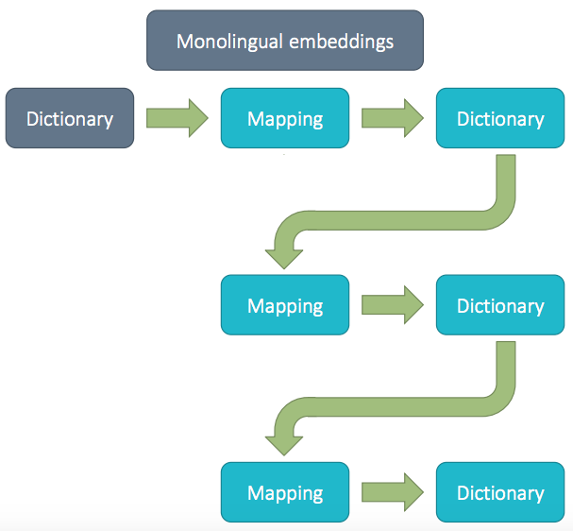
Recent Work – Self-learning Embeddings
Now used as initialization step for doing
Unsupervised(!!) Machine Translation in recent works
from Mikel Artexte’s talk

Slide 84
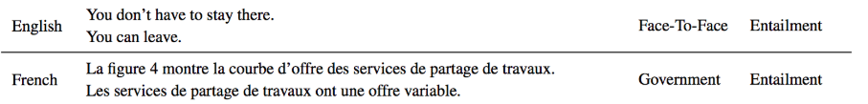
Research Directions
Handling Out of Vocabulary (OOV) Words.
Good Cross-lingual Sentence Representations.
Donaudampfschifffahrtsgesellschaftskapitän
“Danube steamship company captain”
Notes:
Figure 4 shows the supply curve for work sharing services.
Job sharing services have a variable offer.

Slide 85
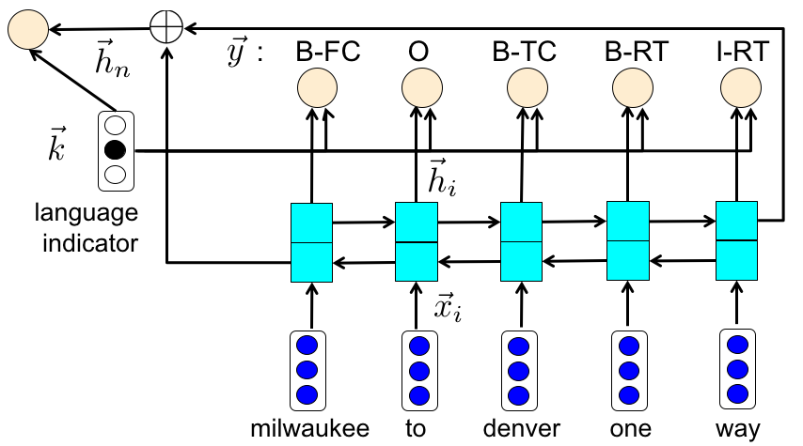
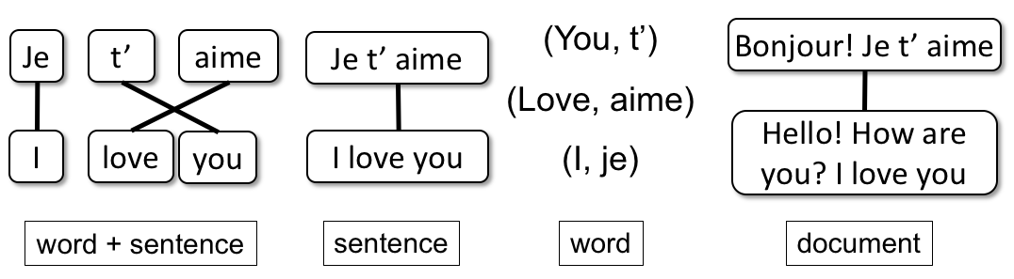
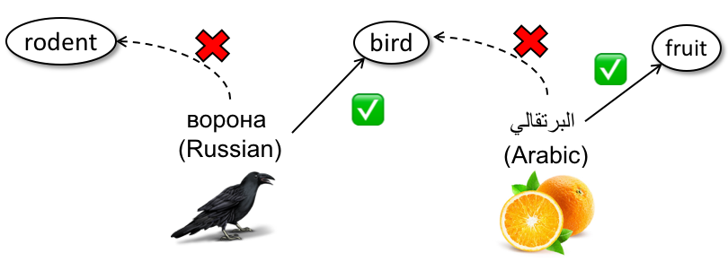
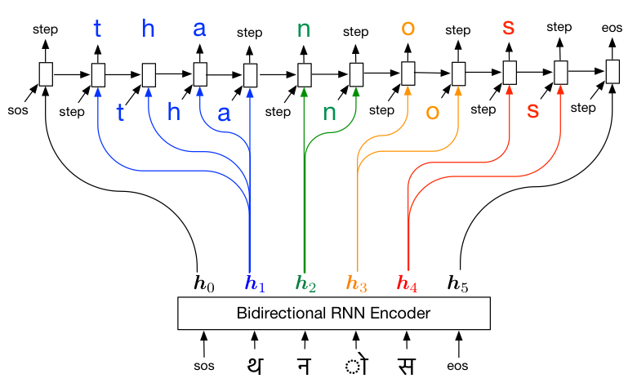
Some of My Work in Cross-lingual NLP
Lexical Semantics
Information Extraction
Value of different forms of cross-lingual alignments
Cross-lingual Spoken Language Understanding
Upadhyay et al. (ACL 2016)
Upadhyay et al. (ICASSP 2018)
Catch me after the class if you are interested in discussing these
Multi-sense
Embeddings with Cross-lingual Signals
Cross-lingual Entity Linking
Upadhyay et al. (Repl4NLP 2017, Best Paper)
Upadhyay et al. (EMNLP 2018)
Low Resource Transliteration
Cross-lingual Lexical Entailment
Upadhyay et al. (NAACL 2018)
Upadhyay et al. (EMNLP 2018)

Slide 86
Questions?

